Slide 1


CAPSTONE-PROJECT
Customer Churn E-Commerce
Presented By- Anmol Dwivedi

Slide 2
List of Contents:
Business Problem Understanding
Modelling Approach Used
Insights from Analysis
Recommendations

Slide 3
Business Problem Understanding
The Problem -
The data set belongs to a leading online E-Commerce company. An online retail E-commerce company wants to know the customers who are going to churn, so accordingly they can approach customer to offer some promos.
Objectives –
To perform data analysis on the given data to find trends.
Build a Predictive Models which can predict the customers who are going to churn.
Choose the best predictive model and check model accuracy parameters.
Come up with Business Insights that can help the company to retain customers.

Slide 4


Scope of the Project:
What is Customer Churn –
Customer churn occurs when customers or subscribers stop doing business with a company or service
Customer Churn reduction leads to –
Higher Revenue
Higher Referral Rates
Increased Up-sales
Higher Customer Lifetime Value
More Customer Acquiring Channels
Establishing Brand Value in the Market

Slide 5

Modelling Approach
Data Acquisition
Performing EDA on the Data
Data Pre-Processing
Model Building
Model Performance Evaluation
Deriving Insights

Slide 6
Model Building Approach
BASE MODEL
TUNE MODEL HYPER -PARAMETERS
MODEL PERFORMACE EVALUATION

Slide 7
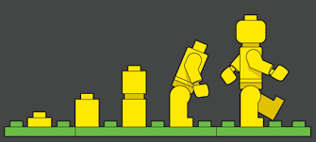
Models Built
Linear Discriminant Analysis
Logistic Regression
ADA-Boost
Support Vector Machines
Gaussian Naïve Bayes
CART / Decision Tress
Random Forest
K-Nearest Neighbours
XG-Boost
Artificial Neural Network/ MLP Classifier

Slide 8

Model Performance Metrics
Accuracy
Recall
Precision
Confusion Matrix
Model Score
AUC Score
ROC-Curve
Most important Model Performance metric -
Model Recall

Slide 9
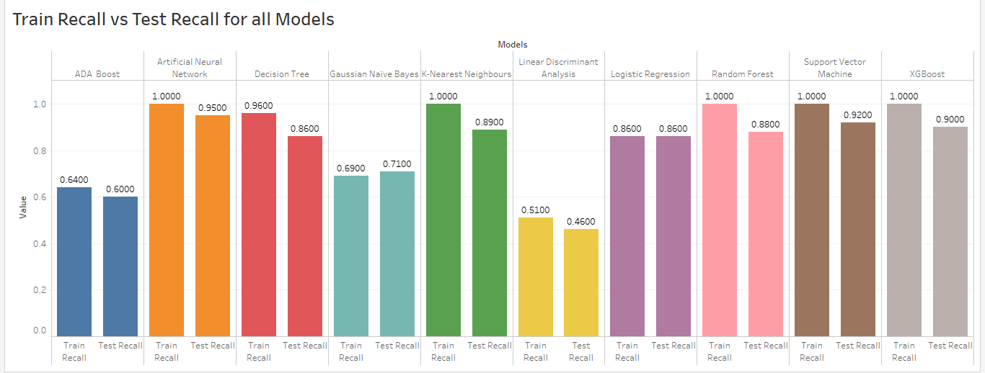

Slide 10
Insights from Analysis
Most of the customers who churned had a tenure of about 15 months.
Customers belonging to low tier cities had a higher churn rate than those in high tier cities.
The customers who churned had lesser number of registered devices with the company.
A major chunk of customers who churned had a satisfaction score of higher than 3.
Customer who raised complaints churned and those who didn't raise complain didn't churn.
Customers whose preferred login device is a mobile churned in lesser amounts than those who prefer computers.

Slide 11
Most Significant Features
Looking at the features importance from Random Forest, Decision Tree, XG-Boost and Logistic Regression, we can figure out which features are most important in customer churn prediction:
Tenure
City Tier
Warehouse to Home
Number of Devices Registered
Satisfaction Score
Number of Address
Complain
Days Since Last Order
Cashback Amount
Preferred Login Device_Mobile
Order Amount Hike From Last Year

Slide 12
Recommendations
The company needs to work on retaining both its old and new customers by providing a greater overall customer experience, better customer engagements, coming up with new offers and discounts etc.
The company needs to come up with more cashback offers and in a wider variety. These can be direct monetary cashbacks or giving out coupons for discounts on future shopping.
The company needs to come up with more distribution centres and work on faster delivery options.
Company should come up with sales and promotional offers frequently to keep the customers engaged. They should constantly try to increase the customer experience and keep selling. The company can come up with daily, weekly or monthly deals to ramp up the sales.
The company must not only engage customers via various means of mass media but also make sure that the customer service department is working smoothly. Customer Services forms an integral part of customer experience and must not be overlooked
The company needs to look at its performance in various cities and make sure that they maintain an equal quality of service. The companies strategies must reflect that all customers are equally important to them.

Slide 13


